Slide 1
USAF-558 - Supply Chain Communication
Carter Vannelli
Matthew Glos
Hao Wang
Ryan Becker
Liuhai Wang

Slide 2
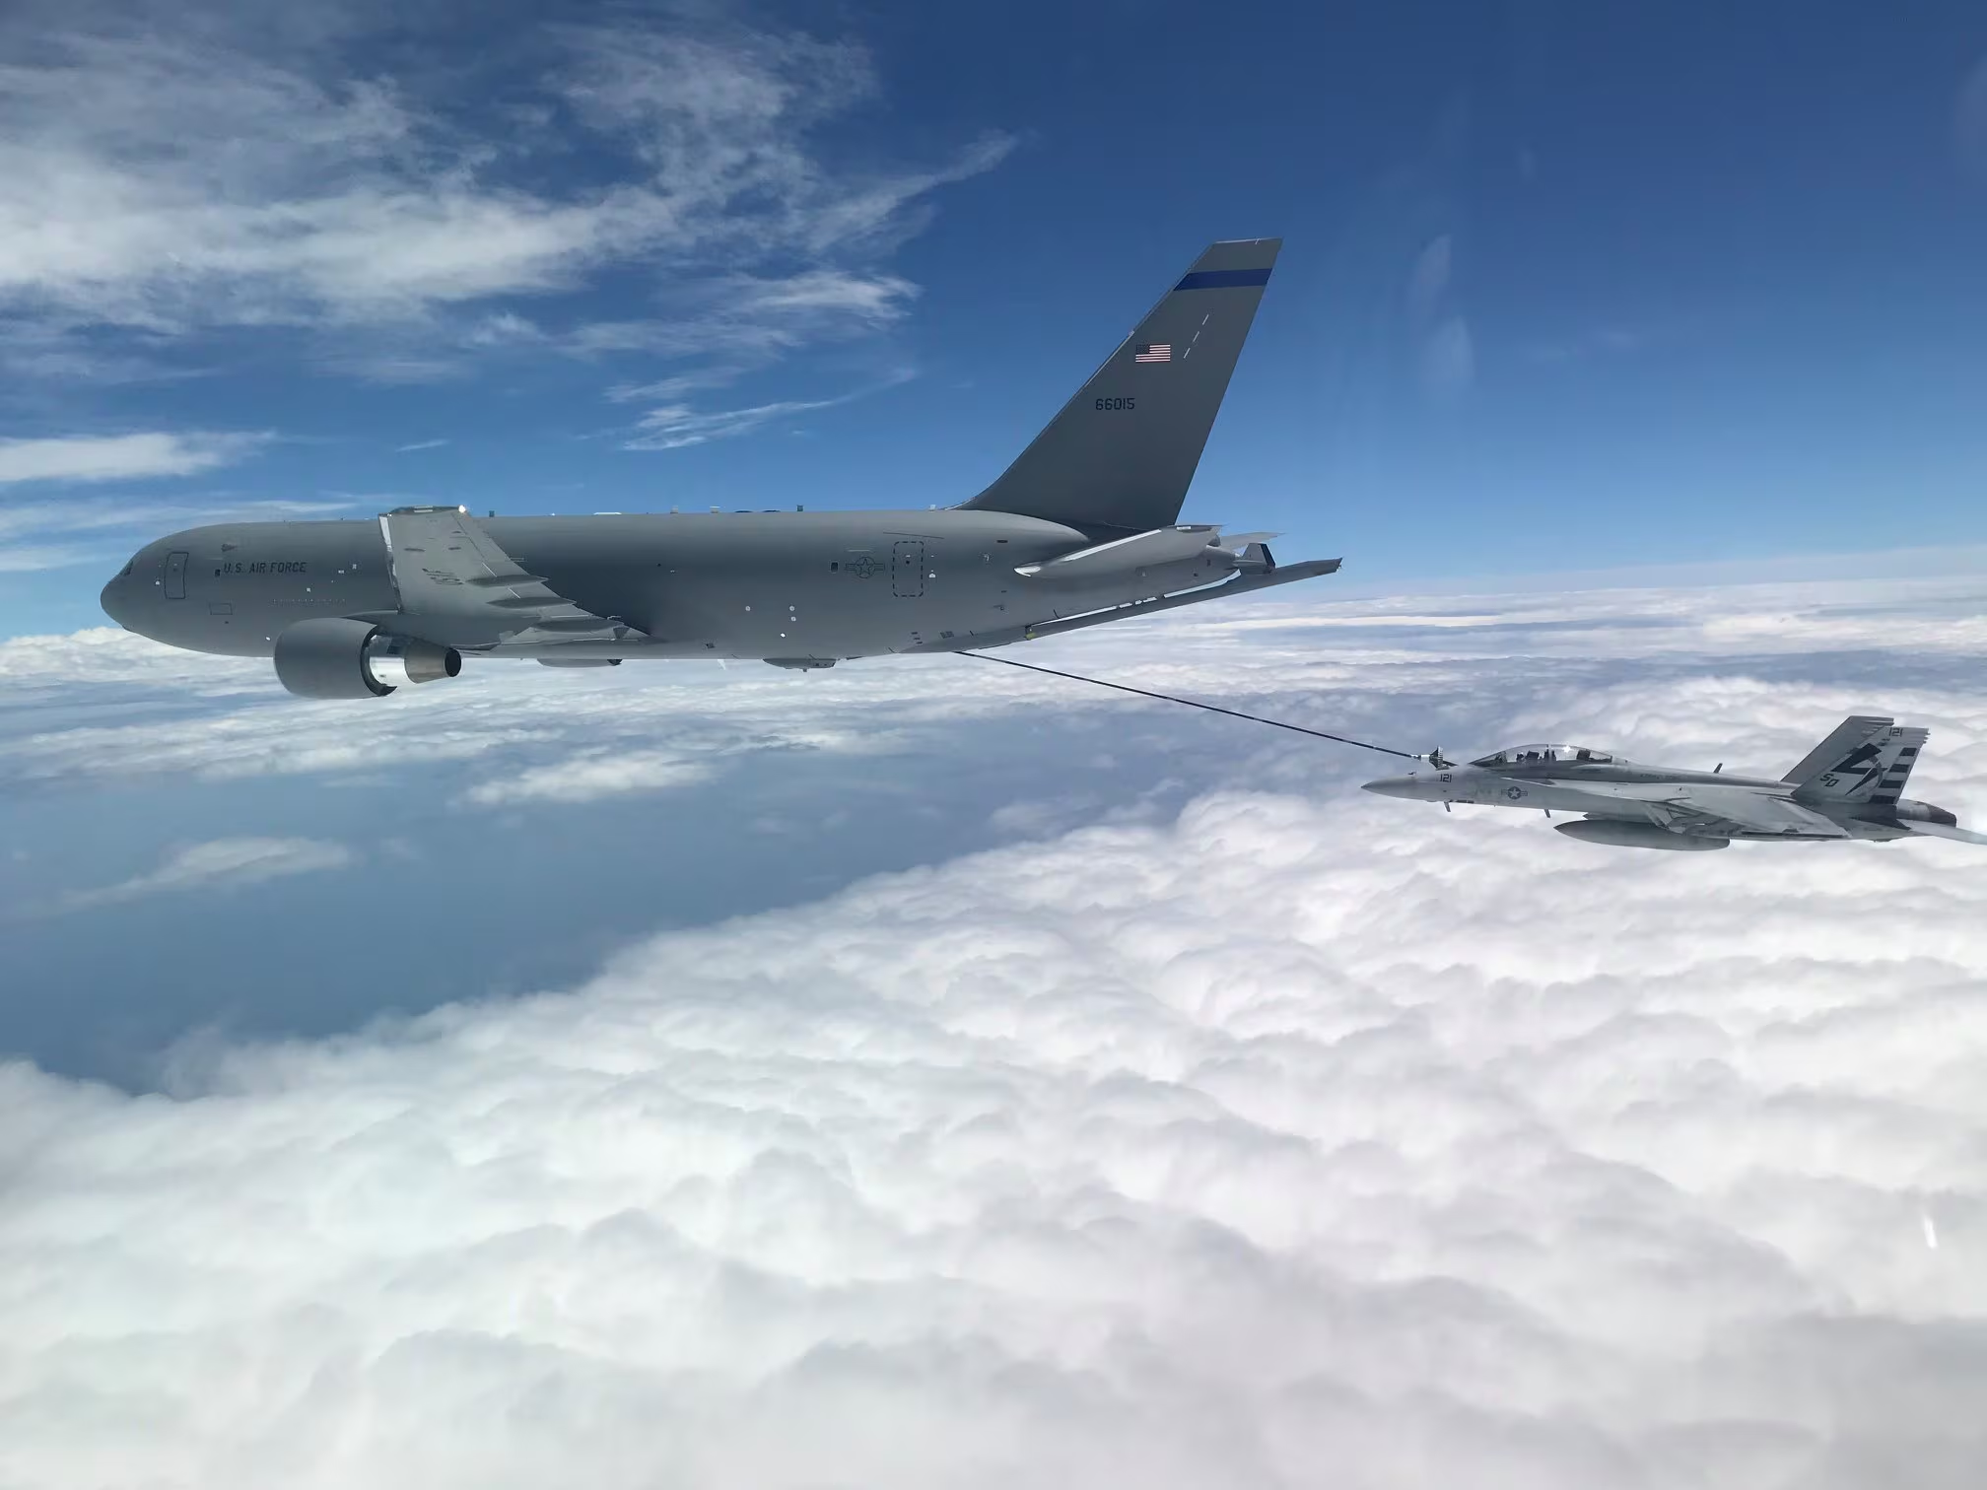
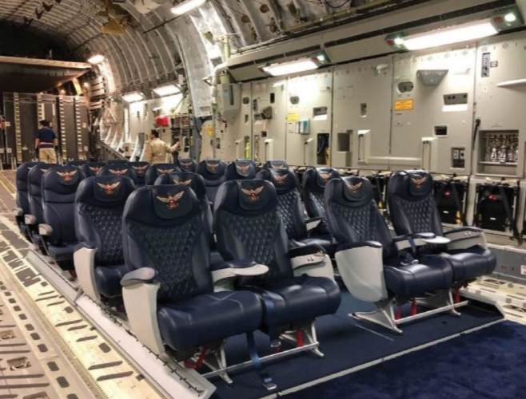
Introduction
KC-46 Crew Chief seems to be in charge of the maintenance of the KC-46 pegasus aircraft (from google)
Current parts breakdown they receive lacks crucial information
Leads to inability to properly order specialized equipment needed for repairs

Slide 3
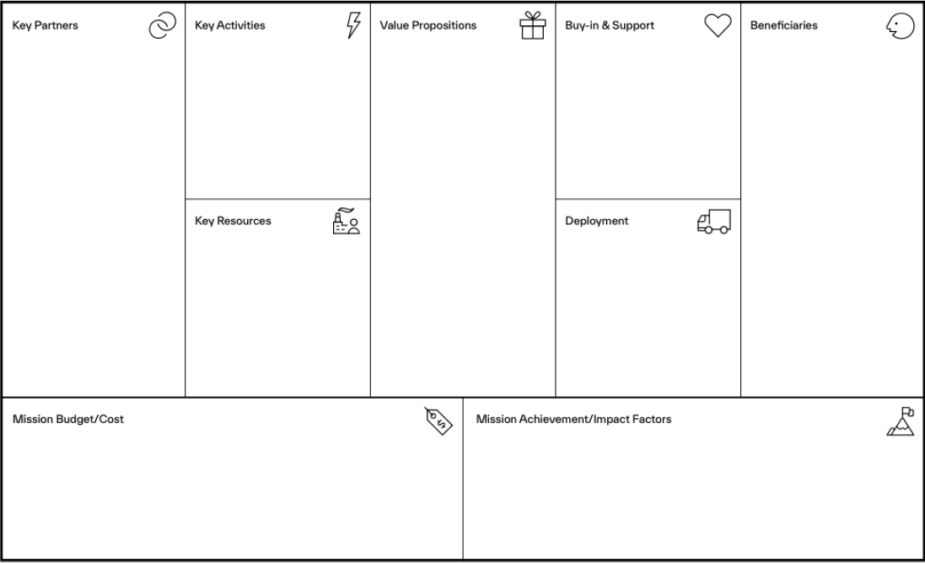
Improve the part ordering process for KC-46 systems
KC-46 Crew
AAR Mobility Systems
KC-46 Crew
AAR Mobility Systems
USAF
KC-46 Aircraft Maintenance Squadron, Aircraft Pilots, Logistics Squadron,
AAR Mobility Systems
Improve efficiency and reliability of KC-46 Seat Pallet repair procedures
Two Printed ETIMS Catalog seat pallet T. O’s
?
Allow end-users to more efficiently inventory,
order, and maintain equipment
?

Slide 4
Connect to VPC
Questions focusing on Jobs
What are KC-46 Crew Chiefs and their teams day to day duties?
How often do the KC-46 Crew Chiefs order specialized equipment?
Questions focusing on Pain
What do they not like about ordering equipment?
What information is missing from the parts breakdown?
Questions focusing on Gains
What would you like to see in a parts breakdown?
What do they like about the current way of ordering equipment?

Slide 5
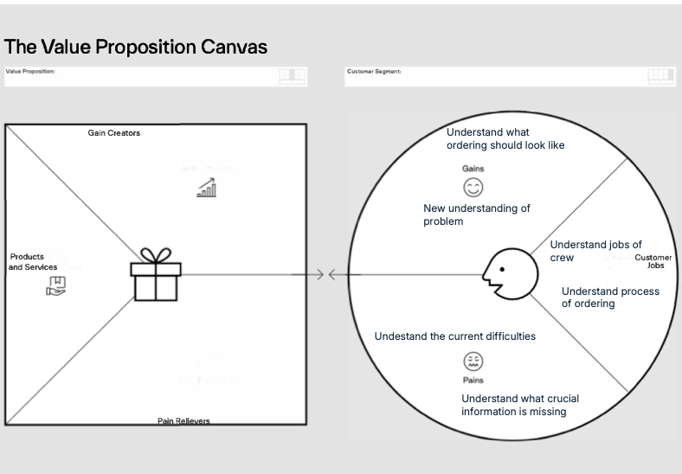

Slide 6
Questions we want to ask
What are KC-46 Crew Chiefs and their teams day to day duties?
How often do the KC-46 Crew Chiefs order specialized equipment?
On average how many active orders are there waiting to be fulfilled?
How does the current process of ordering work?
What do they like about the current way of ordering equipment?
What do they not like about ordering equipment?
What information is missing from the parts breakdown?
What would you like to see in a parts breakdown?
Is there a specific reason why third party technical orders like the seats are not included in the ETIMS catalogue?
Can third party technical orders be more commonly included in the ETIMS catalogue?
Who else can we interview about this subject?

Slide 7
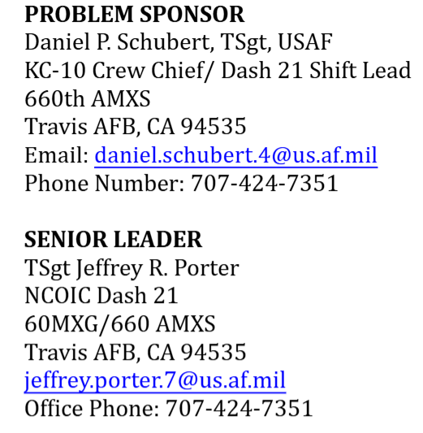
Interview subjects

